Slide 2
>contents
purpose ............................................... 1
vision ................................................ 2
problem ............................................... 3
bitcoin zenon quasar .................................. 4
solution .............................................. 5
why now ............................................... 6
market size ........................................... 7
competition ........................................... 8
product ............................................... 9
economics ......................................... 10-12
team ................................................. 13

Slide 3


Only a moron would spend BTC for a good with non-deflationary value.
But that doesn’t mean that transaction shouldn’t occur.

Slide 4
>purpose
Zenon NoM
PoW/PoS
The Foundation For A Trustless Economy
Decentralized Computing
DAOs DACs
Bitcoin PoW
Zenon is a novel dual-ledger that progressively decentralizes through a dual-coin architecture. By using Bitcoin’s PoW as root consensus, it can make any application, organization, or asset transfer
as trustless as Bitcoin
feeless
mass-scalable
Tokenized Assets
Network
States
zBTC
DeFi
...

Slide 5
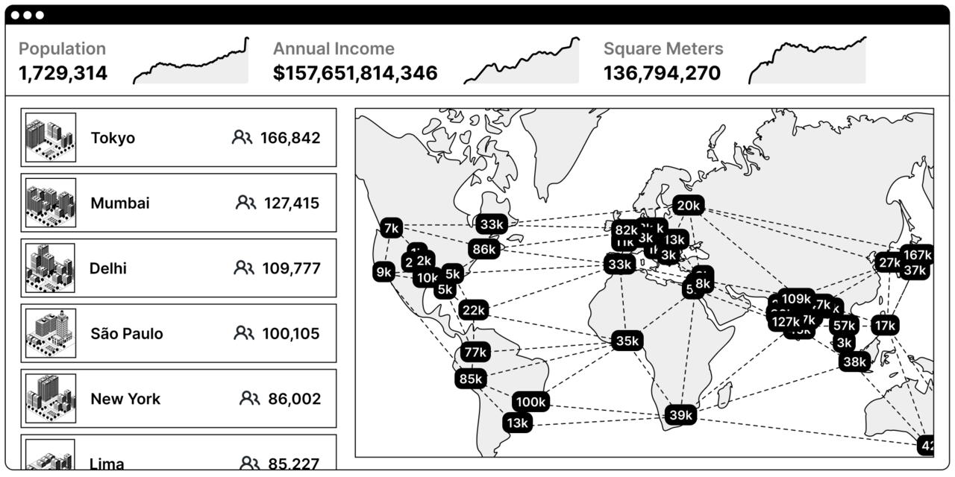
Bitcoin-powered Network States
>vision
Bitcoin’s PoW is the most secure foundation for a trustless global economy and supranational democratic governance.
Zenon was purpose-built to leverage that trustless security and scale it across industry verticals and use cases Bitcoin was not designed for.
The Network State in One Image
by Balaji Srinivasan

Slide 6
>problem
Smart contract L1s failed
Founder cults
Scalability issues
Progressive centralization
Consensus validator oligarchy
Unfair insider advantages from day 1
Bitcoin scaling is not solved
PoW security not reusable beyond native BTC
LN is capital inefficient & not trustless
BTC is not suited for non-deflationary goods
No feeless smart contracts & oracles
Bitcoin is not supposed to scale on mainchain
Notes:
Extremely secure but limited throughput
Deflationary, energy-constrained value
“Supreme Court” for consensus disputes
Scaling Bitcoin’s security for non-energy constrained mass transactions e.g.
Payments for digital goods
DAO/DAC governance
DeFi & asset tokenization
means settling on nested sidechains with consensus based on assigned value.

Slide 7

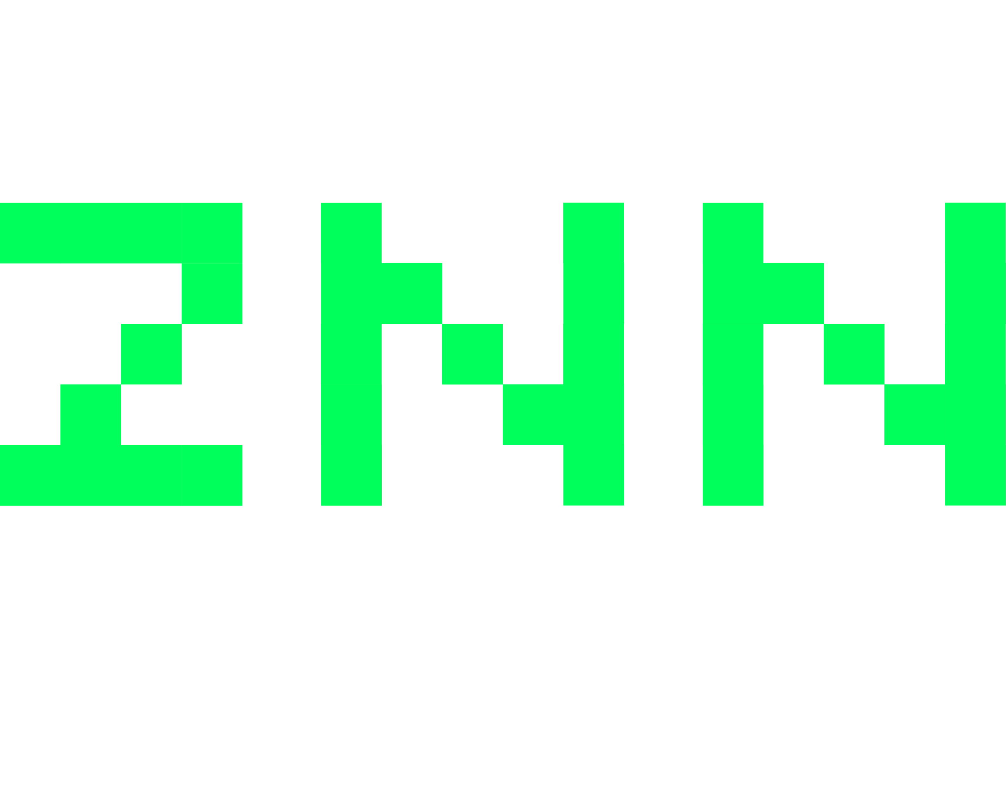

>bitcoin zenon quasar
Digital Gold
Tokenizes energy
Energy constrained value
Proof of Work Layer 1
Deflationary
Mining capacity is based on energy technology & physics
Right to mint is limited by mining hardware
Tender for deflationary goods
Digital Gold Notes
Tokenizes right to mint
Socially assigned value
Smart Contract Layer 1 + 2
Disinflationary
Minting capacity is based on good governance
Right to mint is limited by cyclical delegator assignment
Tender for inflationary goods
Feeless Digital Transactions
Tokenizes TX throughput
Network usage derived value
“Free gas”
Disinflationary
Minting capacity is based on opportunity costs
Right to mint is limited by network security contributions
Tender for network usage

Slide 8




>solution >zenon network of momentum
Layered scaling with Taproot
DeFi
DAOs
DACs
Zenon Network of Momentum Feeless Smart Contract L1 Feeless Bitcoin L2
Dual Ledger Block-Lattice + Meta DAG
Dual Token Economy ZNN = Payment + infra collateral QSR = Tokenized tx throughput
On-Chain Smart Contracts + Oracles & Unikernels + Zenon Token Standard
Progressive Decentralization Egalitarian validator set creation Strong decentralization incentives
zApps
Feeless, trustless apps run on nested sidechains. Pay for services by redirecting delegation rewards
Zenon
zBTC
Sentries are on-chain oracles between mainchain, sidechain, and off-chain data
Pillars validate momentums for Zenon mainchain consensus
Sentinels create PoW links on transactions to validate cross-chain consensus with Bitcoin’s PoW as the “Supreme Court” for consensus disputes
BTC
BTC
BTC
BTC
BTC
Bitcoin
BTC

Slide 9
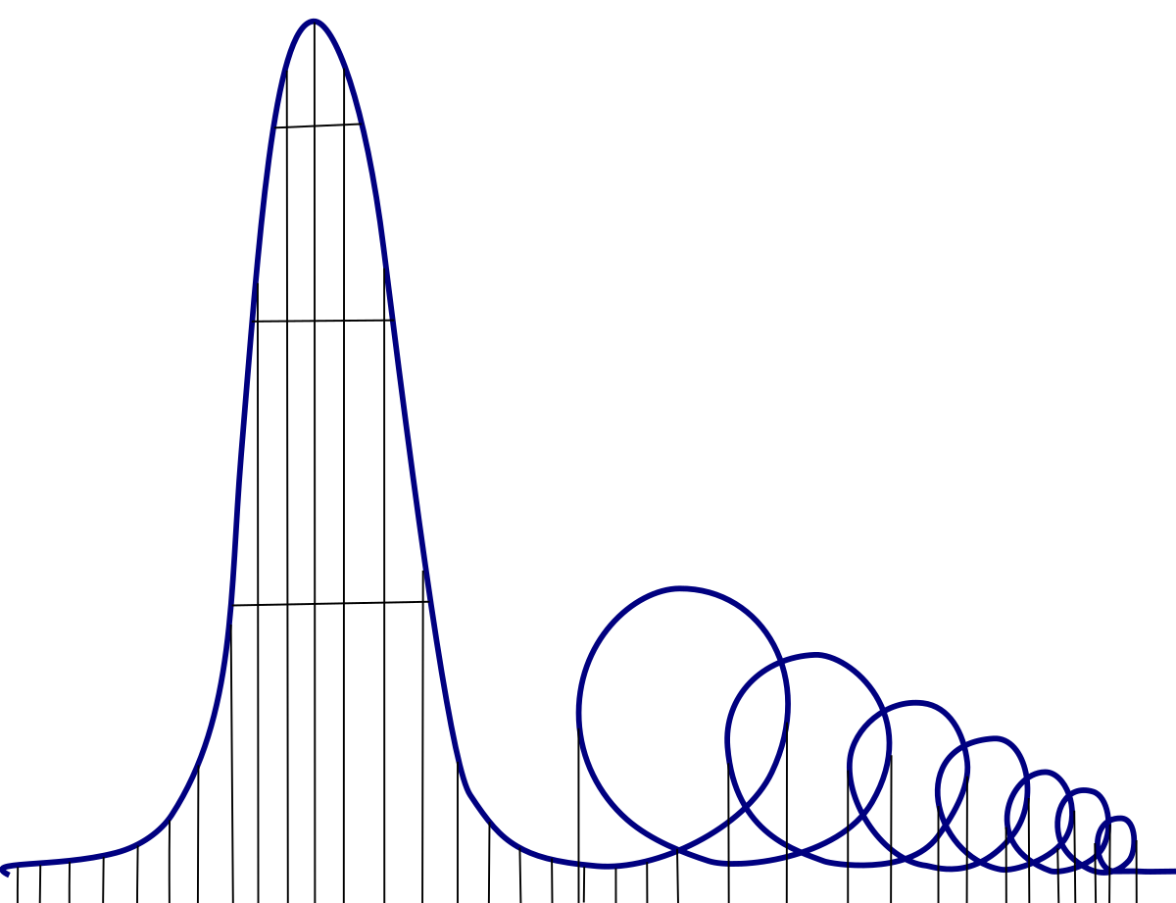




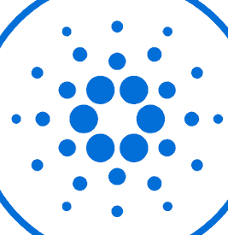
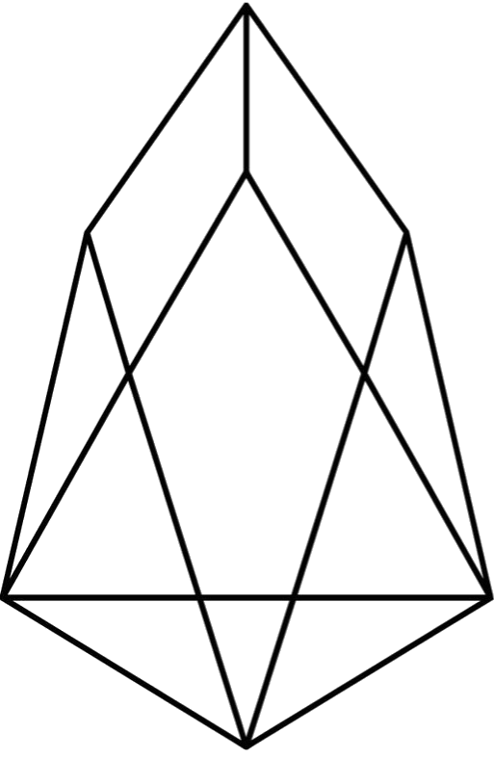
>why now
Real progress means tapping into the roots of Bitcoin.
Corporate Web3 milked the market dry with failing copycat networks.
PoS validators sacrificed censorship resistance to regulators.
CBDCs and the current central bank circus drives smart money to Bitcoin.
Builders want skin in the game and a level playing field - not enriching insiders.
“the merge”
Industry Value
Centralization Euthanasia

Slide 10
>market size
>$14b
on-chain fees would have been saved by Zenon over the last 6 years
assuming
>90% of ETH fees eliminated
>30% of BTC fees eliminated with zBTC
Source: Glassnode

Slide 11







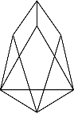


Zenon’s USPs
>competition
∞
Feeless txs
Embedded smart contracts & oracles
Decentralization incentives
MEV resistant
Pure, libertarian genesis w/ BTC refund “xStakes”
Leaderless community
Dogmatic to Bitcoin ethos
NEAR
STX
SOL
TX Fees At Scale
ICP
TRX
DOT
ETH
EOS
AVA
BNB
ADA
0
Oligarchic
Validator Structure
Egalitarian

Slide 12
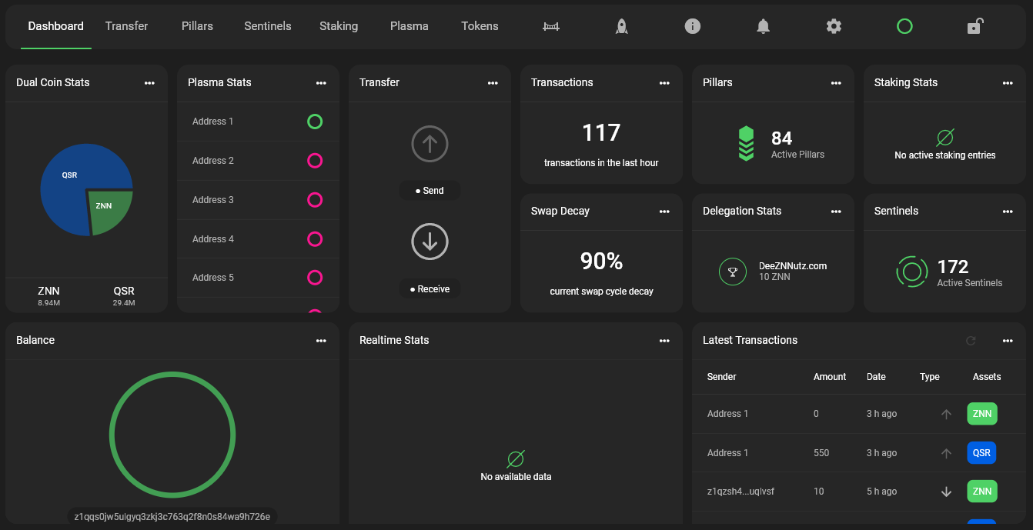
>product

Slide 13
>economics 1/3: genesis distribution
100% Egalitarian. Like Bitcoin.
Almost all ZNN was initially “given away” via a BTC<>ZNN bonding & refund algorithm called “xStakes”.
5k ZNN per 1 BTC
Full BTC refund for committed validators
Network Stability Fund to bootstrap the legacy network was fully distributed to validators
Zenon Fabric Fund consisted of locked ZNN that did not generate any rewards. They are now used to fund Accelerator Z, the Orbital Program and Vested Pillars.

Slide 14





>economics 2/3: scarcity drivers
more infos on zenon.tools
Pillar nodes
Sentinel nodes
Stakers
Delegators
Liquidity Provisioning
Lock 15’000
Lock 5’000
Lock any
Earn 24% of emissions
Earn 13% of emissions
Burn >270’000
Lock 50’000
Earn 50% of emissions
Earn 25% of emissions
started at 150k & increases by 10k per Pillar slot
7-day revoke window every 83 days
Earn 50% of emissions
Earn 13% of emissions
Earn 25% of emissions
3-day revoke window every 27 days
1-12 month lockup periods
no lockup period
no lockup period

Slide 15
>economics 3/3: supply + emissions
protocol emissions after epoch 12 are assumed to remain constant
ZNN Supply | 6.51m | 6.77m | 6.98m | 7.29m | 7.50m | 7.67m | 7.98m | 8.15m | 8.28m | 8.58m | 8.71m | 8.84m
ZNN Emissions | 432k | 259k | 216k | 302k | 216k | 173k | 302k | 173k | 130k | 302k | 130k | 130k
QSR Supply | 25.34m | 25.94m | 26.54m | 27.14m | 27.59m | 28.04m | 28.49m | 28.64m | 28.79m | 28.94m | 29.09m | 29.24m
QSR Emissions | 600k | 600k | 600k | 600k | 450k | 450k | 450k | 150k | 150k | 150k | 150k | 150k
Pillar Burns | 5.83m | 1.28m | 1.05m | 840k | 550k | 410k | 270k | 0 | 0 | 0 | 550k

Slide 16
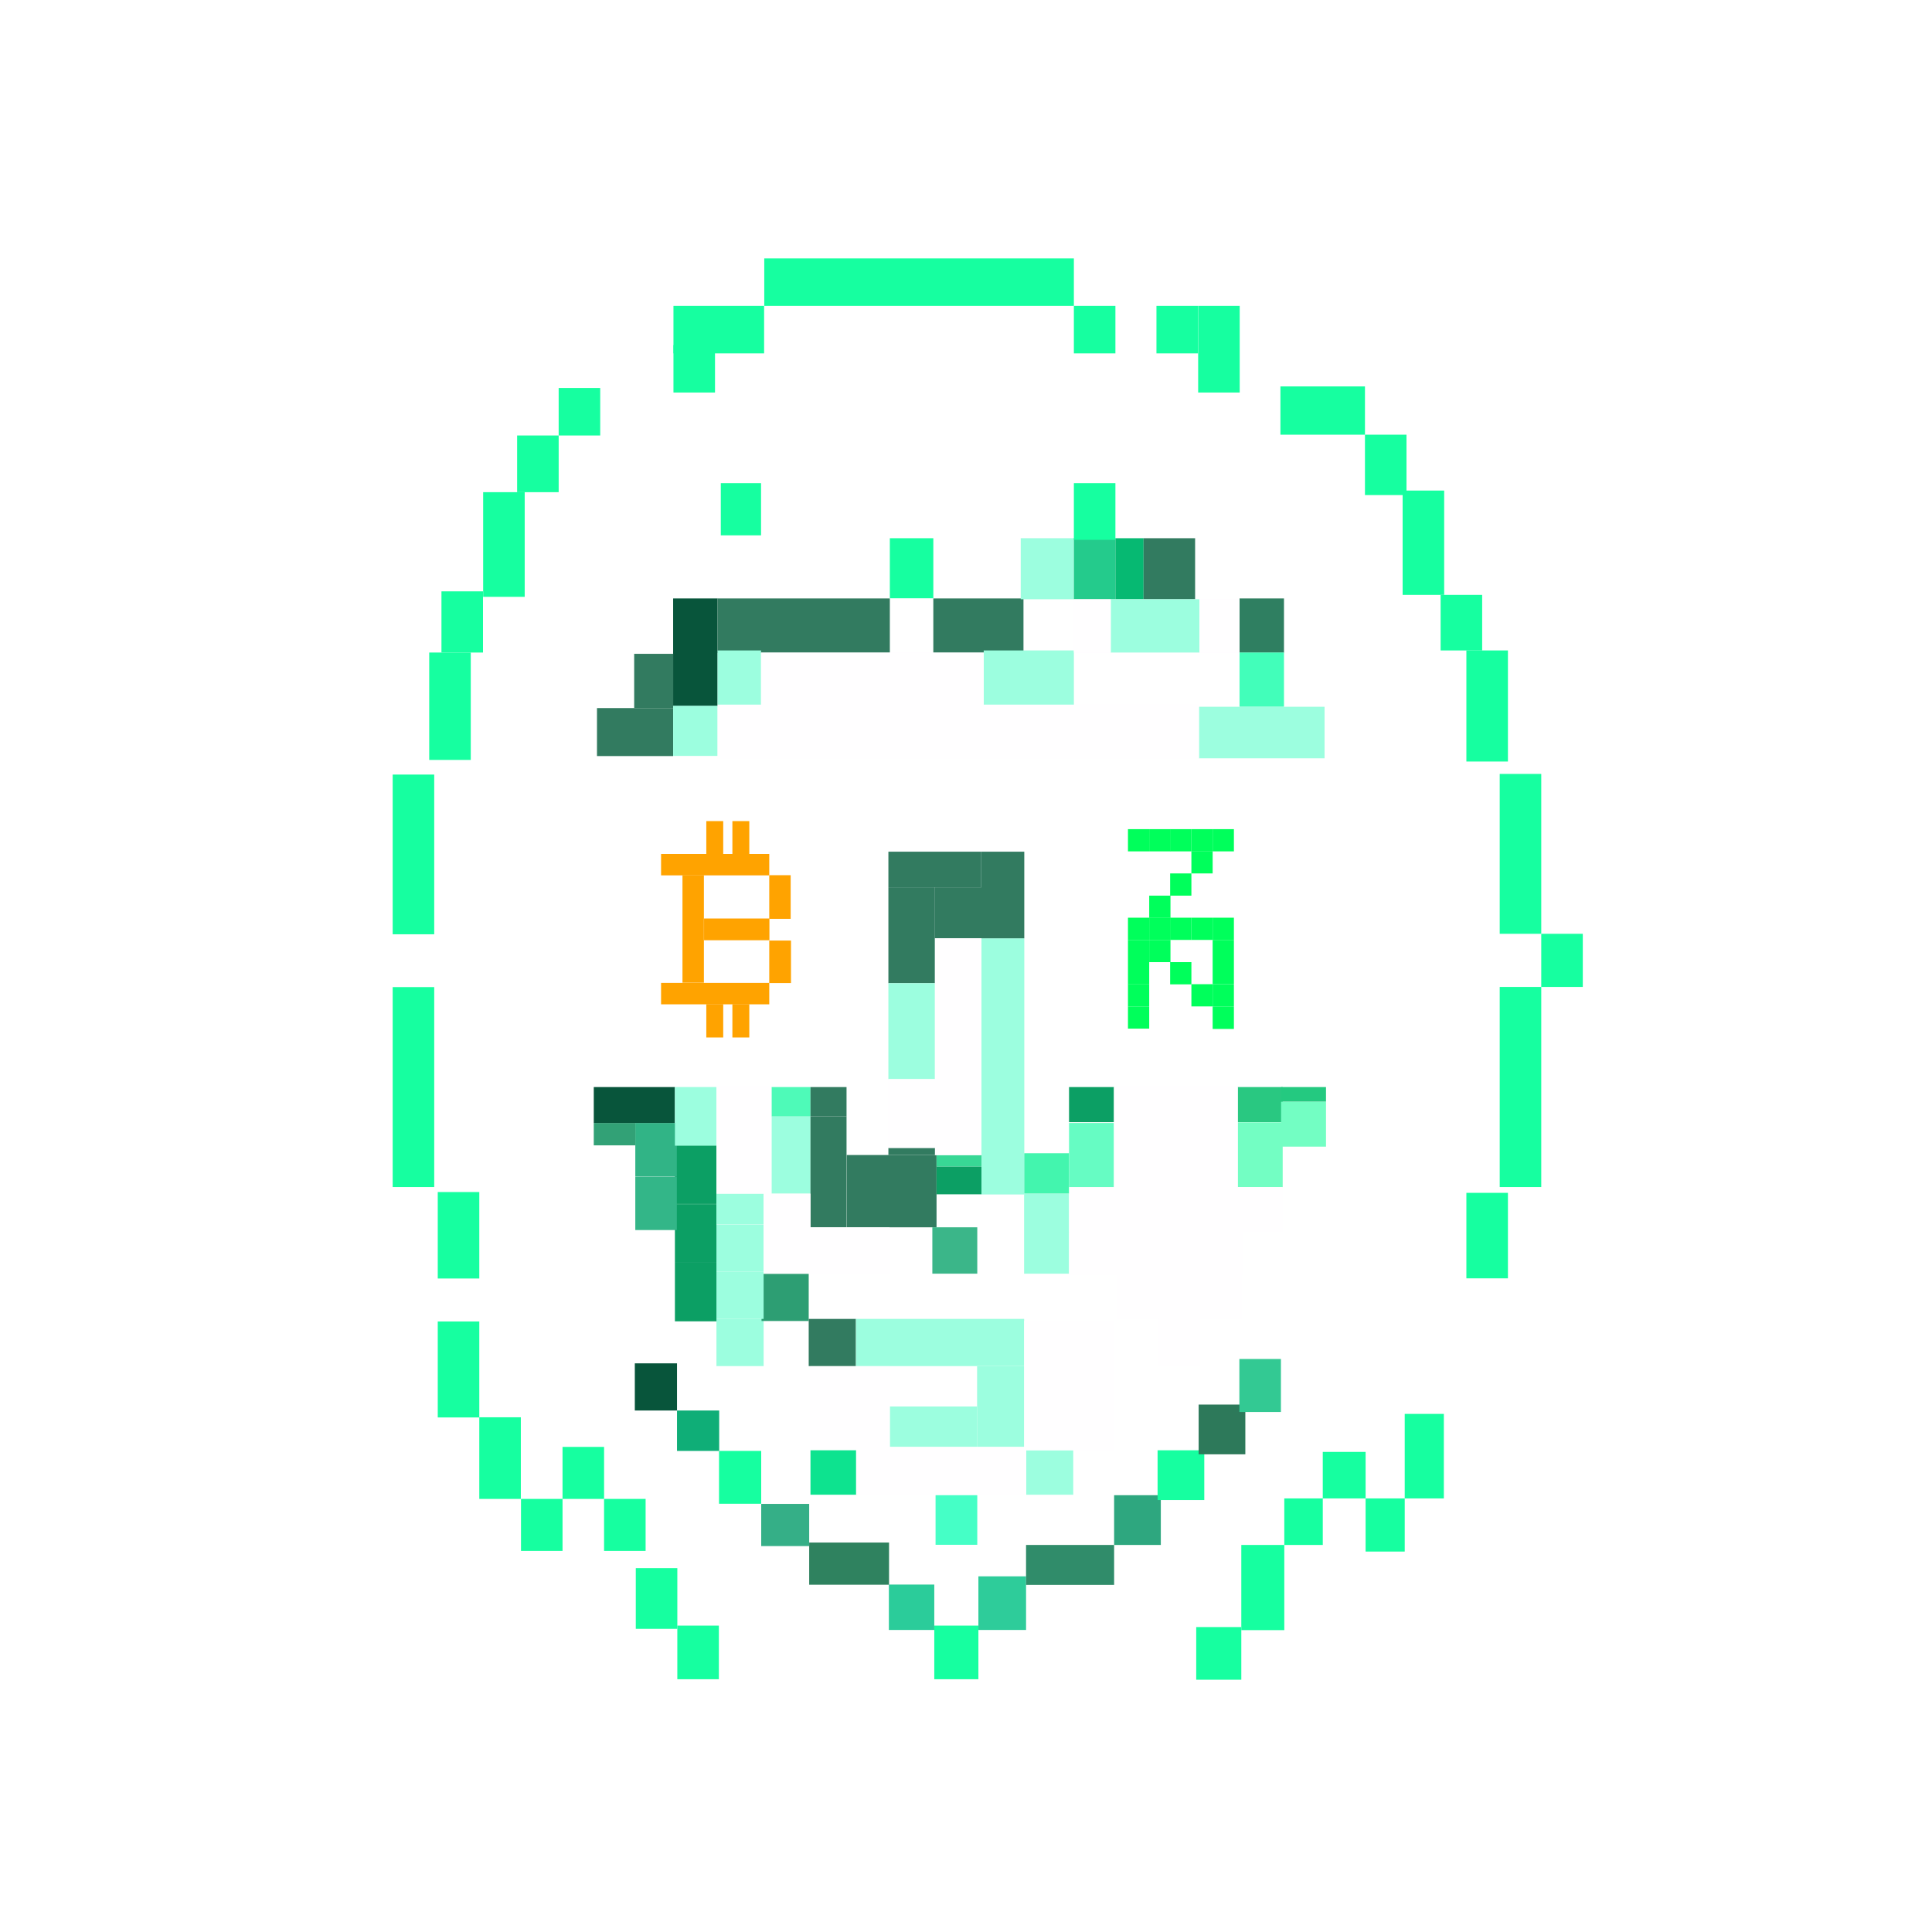
>team
Our developers are anonymous
Our funding source is the community
Our leadership is leaderless
Our credo is “Acta, non verba”
Our devotion is to the cypherpunk ethos
Our culture is the early Bitcoin community’s
Our vision is Network States on Bitcoin
Join the trustless revolution.

Slide 17
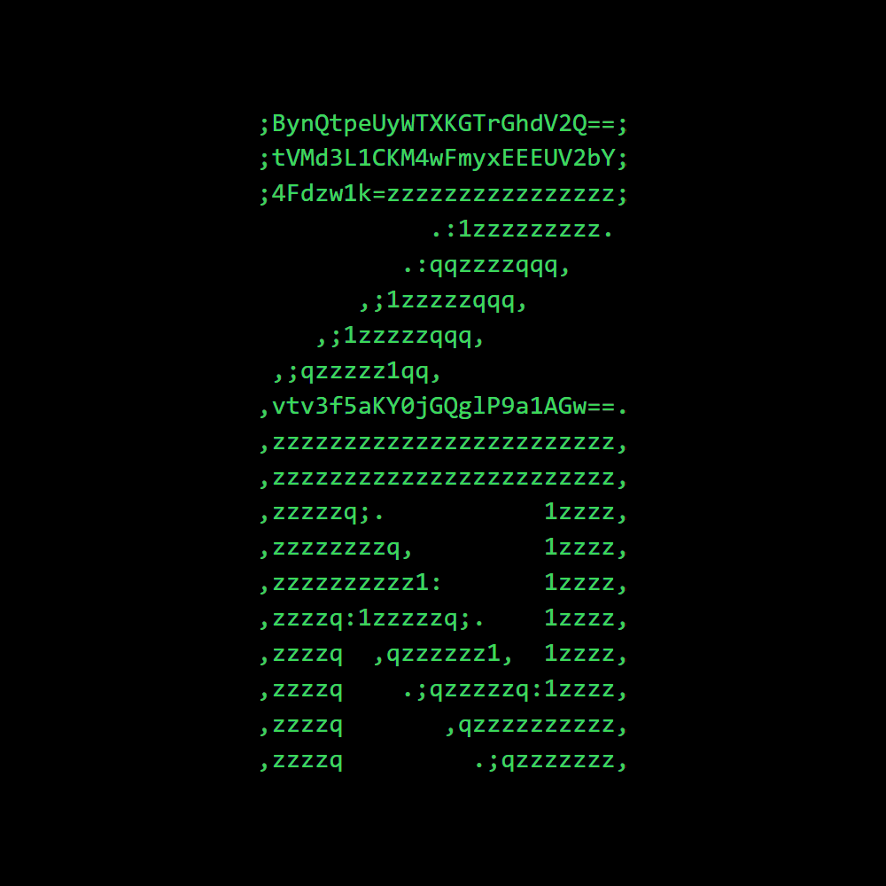
TAPROOT
₿LOCK 709632
“Never doubt you can make history. You already have.”
@zenon_network

Slide 18

Zenon.Network is a community driven project, initiated by anonymous founding developers who are building and delivering the Network of Momentum core protocol quietly behind the scenes.
As such, some of the concepts presented in this deck constitute interpretations and ambitions by the community that are not yet conclusively defined or implemented, and are therefore subject to change pending design and development progress.
@shazzamazzash (Telegram)

